Slide 1


Waitrose delivers 'egg'ceptional Easter campaign on TikTok
How System1 metrics lead to brand lift on TikTok

Slide 2



3 ways to drive brand lift with ads on TikTok
Clear and early branding along with positive emotional pull increased the campaign’s Fast Fluency and Star Rating.
Higher Fast Fluency and Star Rating helped increase Ad Recall by 13.2% in the brand lift study.
The upbeat tone and exciting product range led to Exceptional Star Rating.
Exceptional Star Rating played a key role in driving 4.3% lift in positive attitude towards Waitrose.
Waitrose’s emotionally intense creatives helped reduce dullness and, when paired with Fast Fluency, drove strong Spike Rating.
These Spike Rating scores contributed a solid 2.3% lift in purchase intent.

Slide 3




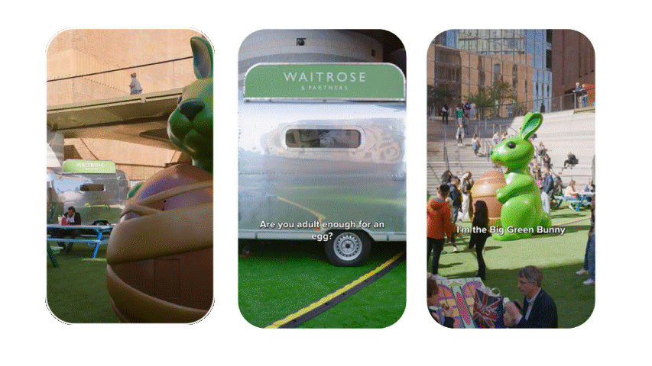
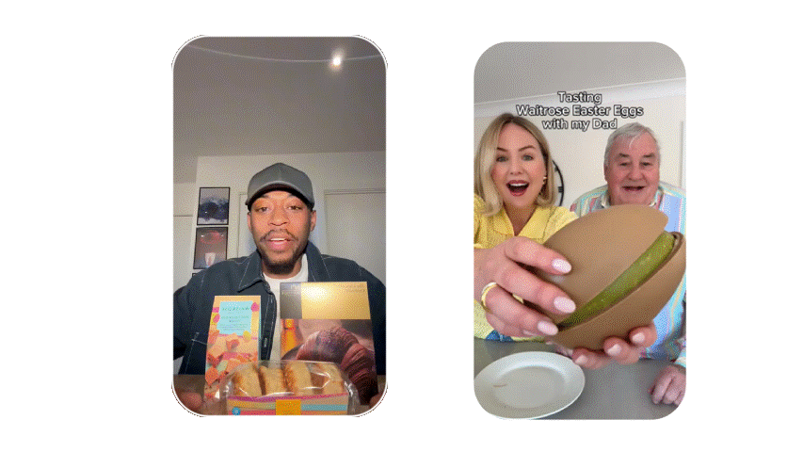

The campaign’s emotional pull, combined with clear and early branding, aids brand recognition and memorability, which helped drive 13.2% brand lift for Ad Recall
Waitrose Easter BLS Results from TikTok
Waitrose Campaign Average:
5.0
64
Star Rating:
Exceptional
Fast Fluency:
Good
Ad Recall
3.6
TikTok Campaign Average:
40
+13.2%
Star Rating:
Good
Fast Fluency:
Low
Significant increase at 95% c.l.
Ad Recall: Did you see any promotional content for Waitrose in the past 2 days on TikTok?
Fast Fluency measures strength of branding in the ad. Fluency is driven by the % of viewers
recognising the brand at 2 seconds.
00:00-00:01s
00:00-00:01s
00:02-00:03s
00:00-00:03s
00:01-00:04s

Slide 4



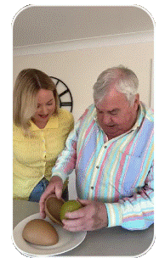



Waitrose’s upbeat tone and wide product range drive a Strong to Exceptional Star Rating, with relatable content supporting a positive lift in Attitude towards Waitrose by 4.3%
Waitrose Easter BLS Results from TikTok
Waitrose Campaign Average:
5.0
Star Rating:
Exceptional
Attitudes
+4.3%
TikTok Campaign Average:
3.6
It was upbeat, fun, and good to see Easter more for adults
Star Rating:
Good
It looks fun
Significant increase at 95% c.l.
Attitudes: How would you rate Waitrose in terms of being a brand that’s relevant to you?
A good range of Easter chocolate at Waitrose and some luxury to enjoy
Tasty and curious, as I love chocolate, and Waitrose is a high-end supermarket
Star Rating predicts the long-term market share growth based on an ad’s creative effectiveness, calculated by measuring emotional response to an ad.
Everyone is enjoying themselves
Reasons for Happiness

Slide 5




The emotionally compelling narrative leads to below average Neutrality, supporting Emotional Intensity which pairs with Fast Fluency to increase viewers’ Purchase Intent by 2.3%
Waitrose Easter BLS Results from TikTok
Waitrose Campaign Average:
1.27
Intent
Spike Rating:
Strong
+2.3%
64
Fast Fluency:
Good
1.68
Emotional Intensity:
Exceptional
Significant increase at 90% c.l.
TikTok Campaign Average:
Intent: How likely are you to buy from Waitrose in the next 2 weeks?
0.95
Spike Rating:
Low
40
Fast Fluency:
Low
1.43
Emotional Intensity:
Strong
Spike Rating predicts short-term sales potential, derived from strength of branding and intensity of emotional response.

