Slide 1
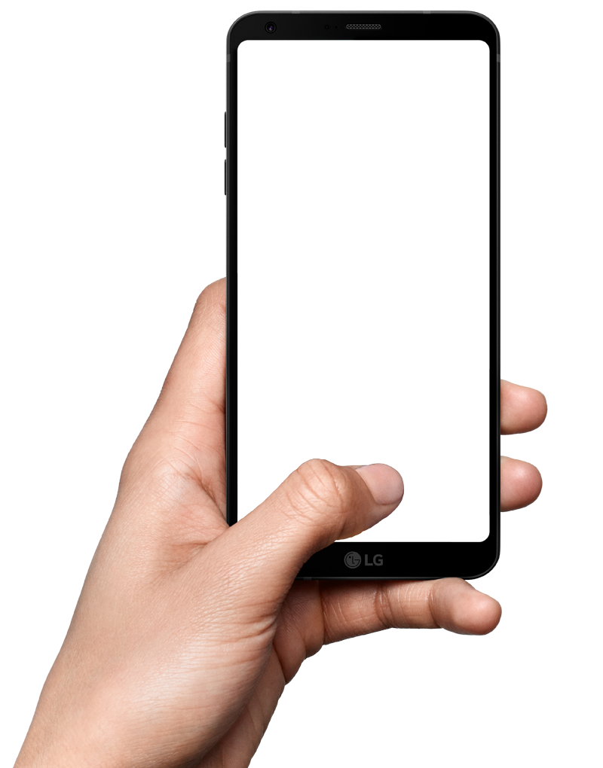
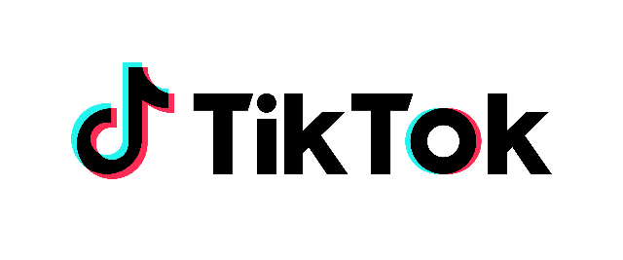
Very Makes it Sparkle on TikTok
Unpacking the 5-Star Formula for Effective TikTok Cut-Downs

Slide 2
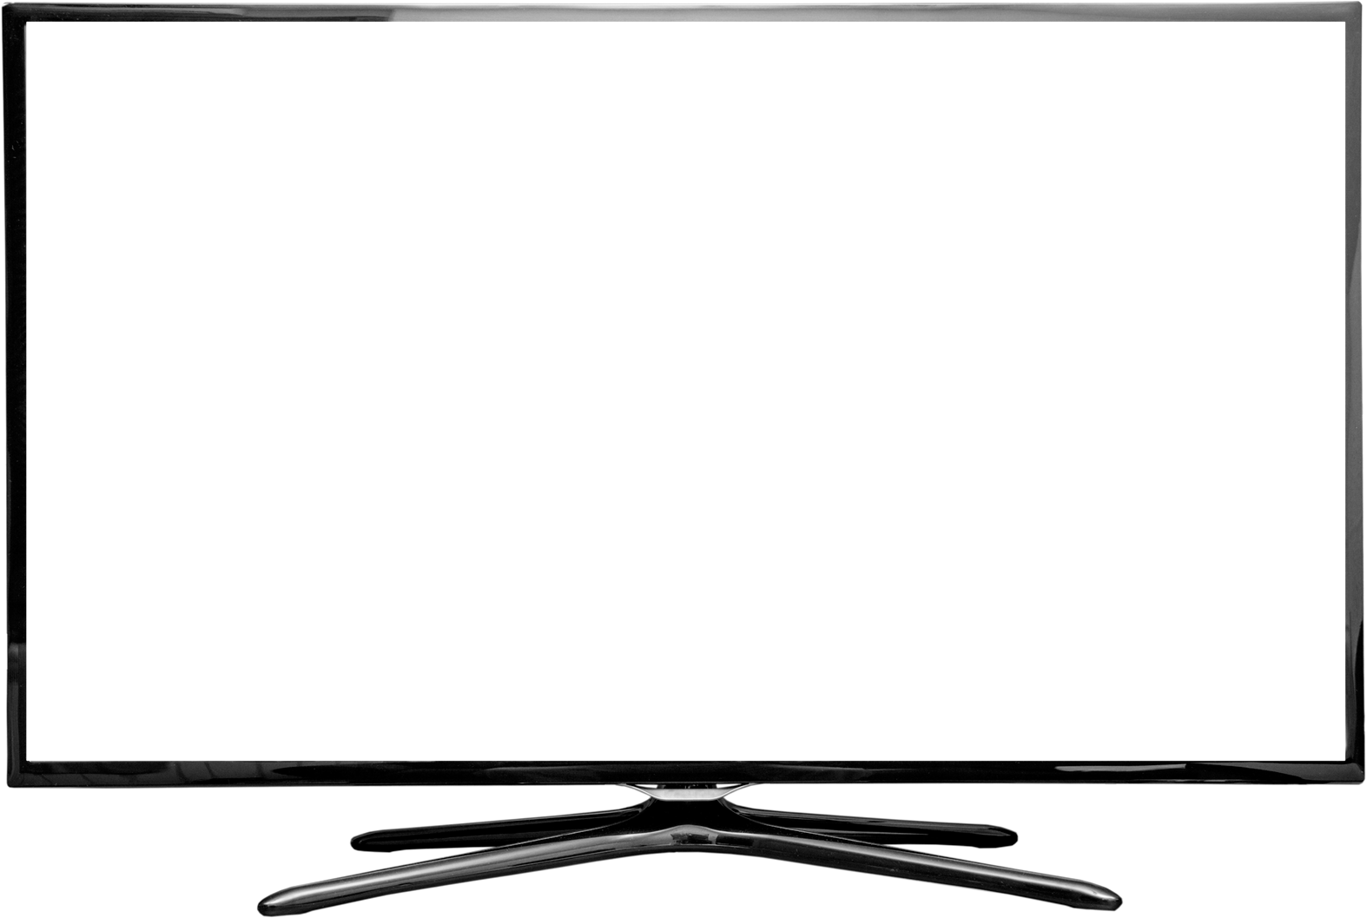
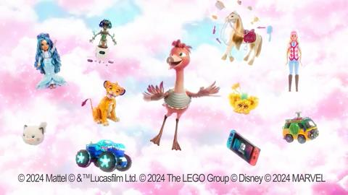
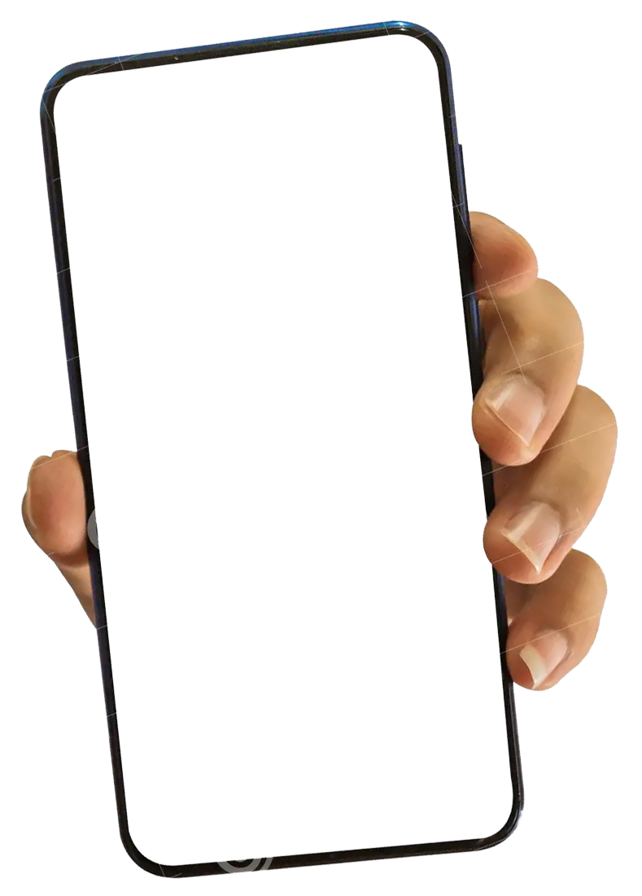
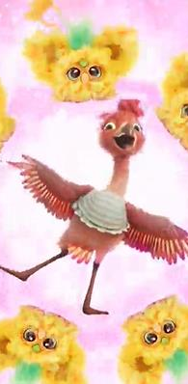
Very successfully used showmanship features to entertain & create a 5-Star TikTok cut-down ad!
Consistent use of showmanship features across channels enhances asset effectiveness by priming audiences
TVC
Showmanship Features
Associated with greater feeling
4.1
Knowing Glances
Story Unfolding
Recognisable Place
Fluent Character
Fluent Tagline
Hummable Tune
TikTok Cut-down
Set in the Past
Character Acting
5.0
Associated with greater attention
© System1 Group PLC
2

Slide 3
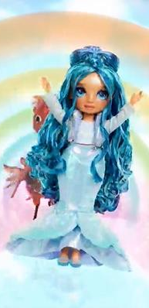
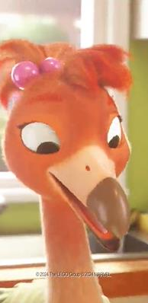
Vibrant visuals hook TikTok users in, emotional features maintain their attention
3.1
5.0
Hook
Maintain
+16% Happiness
Instant Action
Vibrant Visuals
Upbeat Music
Animated Characters
© System1 Group PLC
3

Slide 4
A relevant soundtrack suits the platform & audience, boosting emotional engagement & virality
Reasons for Happiness & Surprise
I love this advert. I like the song, it's so catchy. I like the colours / flamingo
It has a happy tune
The music sequence
Bright, love the music, love the characters
A rework of the 'Boys' song
Click
Click
to play
to play
I like this song but the words are different
Unique twist on an already-known song
I know the song they are referencing
© System1 Group PLC
4

Slide 5
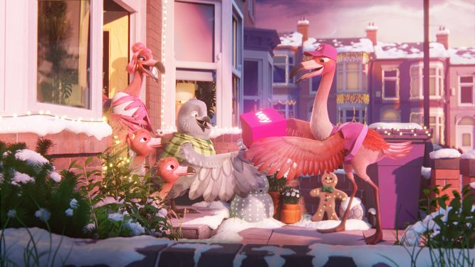
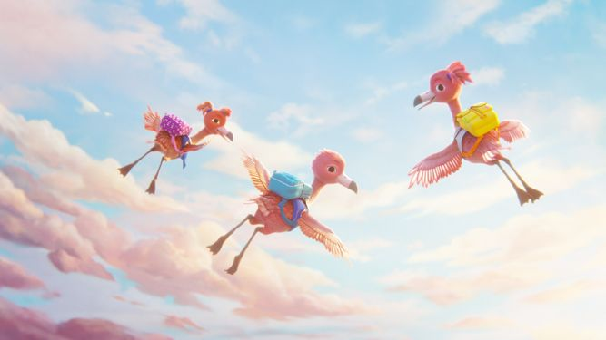
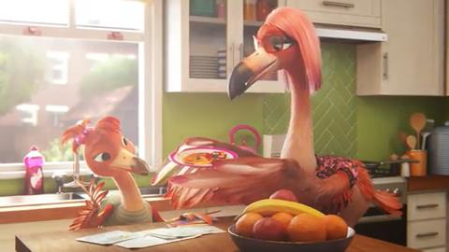
Character fluent devices drive emotional appeal & brand recognition
Let’s make it sparkle Brand Platform
Fast Fluency 2 Second Brand Recognition (%)
Christmas 23 Launch Nov 23
Operation Back to School July 24
Kerry, Terry and Cherry
Introducing chicks Rosa, Otis & Coral
Daydreaming Toys
Oct 24
Christmas 24 Re-airing Nov 2024
+36%
Vibrant Visuals
Upbeat Music
Coral and Cherry
Kerry, Terry and Cherry
© System1 Group PLC
5

Slide 6
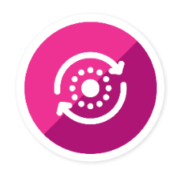
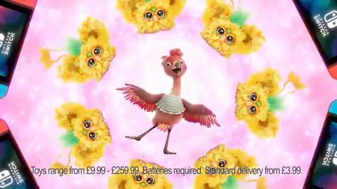
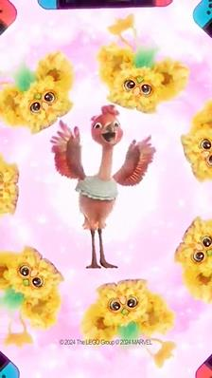
Consistent delivery of distinctive assets & brand personality across channels maximises impact
Consistent Brand Cues
The most consistent brands get
+27% more Very Large Brand Effects
Colours
Characters
Brand Line
Consistent Across Channels
Incorporated by Royal Charter
Click to download the Compound Creativity report
TV
TikTok
© System1 Group PLC
6

