Slide 1
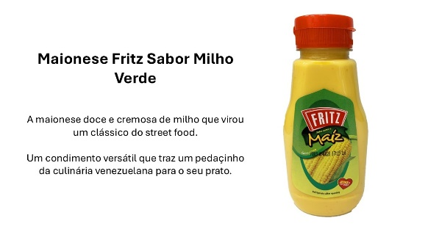
×
NPD
System1
Test Your Innovation for LATAM Kick-off
Nat Rep
PRO REPORT
View The Report

Slide 2
Idea Ranking
Nat Rep | Base size: | 400
8 NPD tested
1 | Cheetos Mac 'N Cheese
2 | Quest S'mores Protein Bar
3 | Principe Lime Cookies
4 | Sour Punch Grape Straws
5 | Takis Blue Heat
6 | Duke's Smoked Sausages
7 | Fritz Salsa Sabor a Maiz
8 | Vigo Cilantro Lime Rice
9
10
2.3
2.2
1.6
1.4
1.1
1.1
1.0
1.0
Low | Moderate | Good | Strong | Exceptional
50% of Ideas | 25% of Ideas | 10% of Ideas | 10% of Ideas | 5% of Ideas
NPD
Test Your Innovation for LATAM Kick-off
20 May 2025

Slide 3
Star Rating
Nat Rep | Base size: | 400
Category Average Star
Star Rating predicts the expected sales potential of each idea
NPD
Test Your Innovation for LATAM Kick-off
20 May 2025

Slide 4
Emotional Response
Nat Rep | Base size: | 400
Intensity Score*
Contempt
Disgust
Anger
Fear
Sadness
Neutral
Happiness
Surprise
*Overall emotional intensity of all (non-neutral) emotions felt, scale from 0-3
We ask people how they feel about each idea using our FaceTrace® emotional measurement tool
NPD
Test Your Innovation for LATAM Kick-off
20 May 2025

Slide 5
Share Trading
Nat Rep | Base size: | 400
Top Quartile
(>82)
Second Quartile
(74-82)
Bottom Half
(<74)
% of people who would probably buy shares in each idea
NPD
Test Your Innovation for LATAM Kick-off
20 May 2025

Slide 6
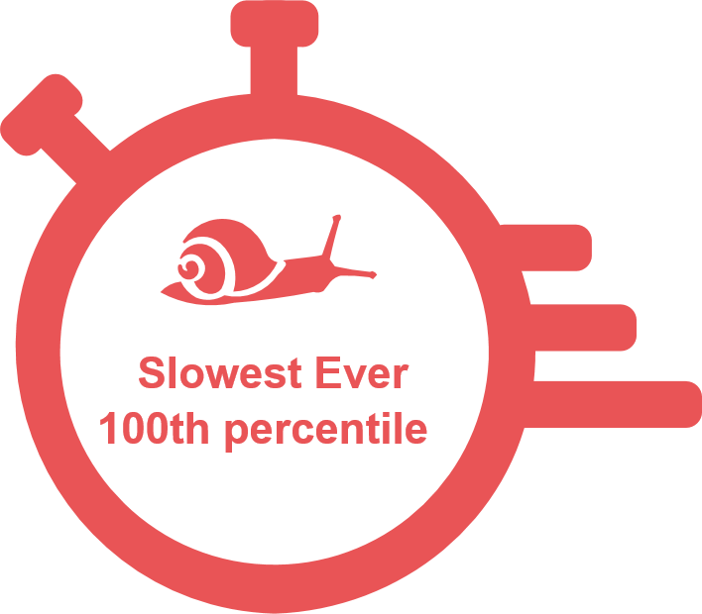
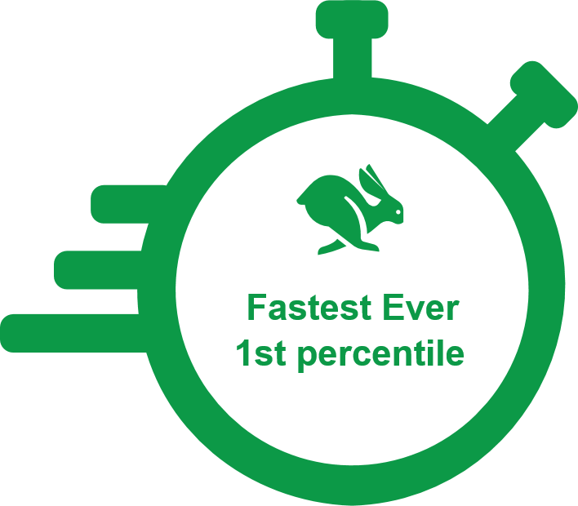
Speed of Trading
Nat Rep | Base size: | 400
Fluency of the ideas is measured by the decision time taken to buy or sell shares in each idea
NPD
Test Your Innovation for LATAM Kick-off
20 May 2025

Slide 7
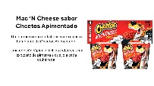
Cheetos Mac 'N Cheese
Nat Rep | Base size: | 400
2.3
Emotional Response
Contempt
Disgust
Anger
Fear
Sadness
Neutral
Happiness
Surprise
Share Trading
Speed of Trading
Percentile
Median Trade Time
Intensity Score
Overall emotional intensity of all (non-neutral) emotions felt, scale from 0-3
56 | ^{th}
05.88 | s
2.3
NPD
Back To Idea Ranking
Cheetos Mac 'N Cheese
20 May 2025

Slide 8
Reasons for Emotion
Nat Rep | Base size: | 400
In my opinion, Cheetos don't go well with chili.
Contempt
Disgust
Anger
Fear
Sadness
Neutral
Happiness
Surprise
I tried Mac and cheese and hated it; a Cheetos version could be worse
Why is a brand for children not successful if it is spicy?
It's not to my taste
About pepper flavor...not everyone likes this idea...but it would be everyone's taste
The spicy taste may not be so good for some people.
Because the colors are not flashy
I like salty snacks and spicy ones are my favorite
It is a very well-known brand with great products and prices.
Everything from Cheetos is delicious and this combination would break hearts, please launch
Everything from Cheetos is delicious and this combination would break hearts, please.
Because everyone loves that cheese flavor
Intensity Score
Overall emotional intensity of all (non-neutral) emotions felt, scale from 0-3
Interesting idea
I liked the idea
Because it's very good
A great piece of news that certainly surprised me
Because it's a brand that reminds me of nostalgia and this combination is super different.
COUNTRY AVERAGE | YOUR IDEA
2.3
NPD
Back To Idea Ranking
Cheetos Mac 'N Cheese
20 May 2025

Slide 9
Advantages & Improvements
Nat Rep | Base size: | 400
Main Advantages of the idea
How to improve the idea
2.3
NPD
Back To Idea Ranking
Cheetos Mac 'N Cheese
20 May 2025

Slide 10
Implicit Attributes
Nat Rep | Base size: | 400
2.3
NPD
Back To Idea Ranking
For values <0.5%, labels report as 0%
Cheetos Mac 'N Cheese
20 May 2025

Slide 11
Target Appeal
Nat Rep | Base size: | 400
2.3
NPD
Back To Idea Ranking
Cheetos Mac 'N Cheese
20 May 2025

Slide 12
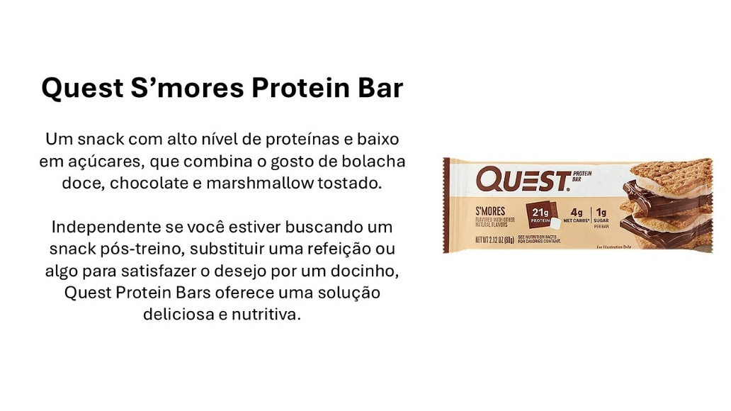
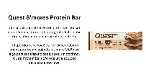
Quest S'mores Protein Bar
Nat Rep | Base size: | 400
2.2
Emotional Response
Contempt
Disgust
Anger
Fear
Sadness
Neutral
Happiness
Surprise
Share Trading
Speed of Trading
Percentile
Median Trade Time
Intensity Score
Overall emotional intensity of all (non-neutral) emotions felt, scale from 0-3
66 | ^{th}
06.50 | s
2.2
NPD
Back To Idea Ranking
Quest S'mores Protein Bar
20 May 2025

Slide 13
Reasons for Emotion
Nat Rep | Base size: | 400
These proteins have a lot of carbohydrates and in my case it would not be necessary.
Contempt
Disgust
Anger
Fear
Sadness
Neutral
Happiness
Surprise
I don't have much to say without knowing the product well.
Normal
This idea does not show much confidence about the product in question.
Why I don't like this product
It involves chocolate that brings joy and pleasure to consume
Nowadays, this type of product is viewed by people who are looking for a fit lifestyle.
Fit the taste seems like it would be good
I've always thought S'mores were delicious and I think the idea would sell well.
It's a great brand
Intensity Score
Overall emotional intensity of all (non-neutral) emotions felt, scale from 0-3
It looks really tasty, and it's easier and more attractive to promote.
Looks pretty satisfactory
I thought the idea was great for selling or buying, an idea worth investing in.
very good at first sight
I seem to love this packaging and the product looks very tasty and satisfying.
COUNTRY AVERAGE | YOUR IDEA
2.2
NPD
Back To Idea Ranking
Quest S'mores Protein Bar
20 May 2025

Slide 14
Advantages & Improvements
Nat Rep | Base size: | 400
Main Advantages of the idea
How to improve the idea
2.2
NPD
Back To Idea Ranking
Quest S'mores Protein Bar
20 May 2025

Slide 15
Implicit Attributes
Nat Rep | Base size: | 400
2.2
NPD
Back To Idea Ranking
For values <0.5%, labels report as 0%
Quest S'mores Protein Bar
20 May 2025

Slide 16
Target Appeal
Nat Rep | Base size: | 400
2.2
NPD
Back To Idea Ranking
Quest S'mores Protein Bar
20 May 2025

Slide 17
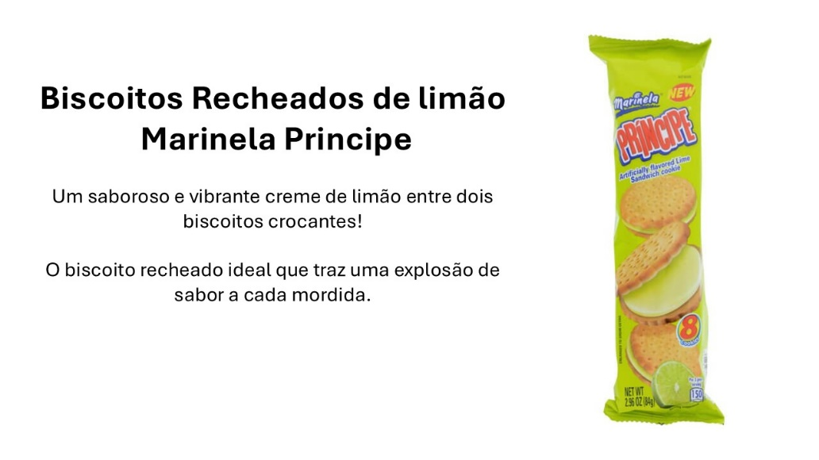
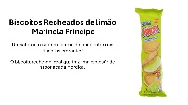
Principe Lime Cookies
Nat Rep | Base size: | 400
1.6
Emotional Response
Contempt
Disgust
Anger
Fear
Sadness
Neutral
Happiness
Surprise
Share Trading
Speed of Trading
Percentile
Median Trade Time
Intensity Score
Overall emotional intensity of all (non-neutral) emotions felt, scale from 0-3
62 | ^{nd}
06.24 | s
1.6
NPD
Back To Idea Ranking
Principe Lime Cookies
20 May 2025

Slide 18
Reasons for Emotion
Nat Rep | Base size: | 400
There are already a lot of these types
Not very pleasant taste
Contempt
Disgust
Anger
Fear
Sadness
Neutral
Happiness
Surprise
Not at all healthy.
I didn't find it attractive and it gives the impression of something bad.
It's not an attractive idea.
Because it is a very unnoticeable idea.
I've tried other lemon-flavored cookies, but I always found them sickening.
I don’t like it
I love the taste of lemon
Everyone would like it
Very good lemon
Lemon has a unique and refreshing flavor and most people like it.
Biscuits with lemon filling are wonderful
Intensity Score
Overall emotional intensity of all (non-neutral) emotions felt, scale from 0-3
Different
It's an innovative flavor...I've never tried it before.
Lemon flavored cookies have everything to be delicious
It's a novelty in the market
Unique taste
COUNTRY AVERAGE | YOUR IDEA
1.6
NPD
Back To Idea Ranking
Principe Lime Cookies
20 May 2025

Slide 19
Advantages & Improvements
Nat Rep | Base size: | 400
Main Advantages of the idea
How to improve the idea
1.6
NPD
Back To Idea Ranking
Principe Lime Cookies
20 May 2025

Slide 20
Implicit Attributes
Nat Rep | Base size: | 400
1.6
NPD
Back To Idea Ranking
For values <0.5%, labels report as 0%
Principe Lime Cookies
20 May 2025

Slide 21
Target Appeal
Nat Rep | Base size: | 400
1.6
NPD
Back To Idea Ranking
Principe Lime Cookies
20 May 2025

Slide 22
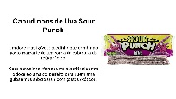
Sour Punch Grape Straws
Nat Rep | Base size: | 400
1.4
Emotional Response
Contempt
Disgust
Anger
Fear
Sadness
Neutral
Happiness
Surprise
Share Trading
Speed of Trading
Percentile
Median Trade Time
Intensity Score
Overall emotional intensity of all (non-neutral) emotions felt, scale from 0-3
67 | ^{th}
06.53 | s
1.4
NPD
Back To Idea Ranking
Sour Punch Grape Straws
20 May 2025

Slide 23
Reasons for Emotion
Nat Rep | Base size: | 400
Does not match my sales
I believe it would not be well accepted by the public, especially children.
Contempt
Disgust
Anger
Fear
Sadness
Neutral
Happiness
Surprise
Ugly packaging and a weird taste
I don't think the idea is very good, and the packaging is also ugly and could be bad.
I think it's very bad for your health
I don't find the product attractive
Because I didn't find it interesting
I don't like this flavor
I don't really like bitter things.
I just wait lying
Tasty
Because it is a well-known product and is loved by many consumers
Why does it look tasty and sweet?
Because it is an excellent product, with varied flavors
I love it.
Intensity Score
Overall emotional intensity of all (non-neutral) emotions felt, scale from 0-3
It would be very different, I think a little sour...but I like it.
It's a good idea, I think it would be a sales success.
different flavor
COUNTRY AVERAGE | YOUR IDEA
1.4
NPD
Back To Idea Ranking
Sour Punch Grape Straws
20 May 2025

Slide 24
Advantages & Improvements
Nat Rep | Base size: | 400
Main Advantages of the idea
How to improve the idea
1.4
NPD
Back To Idea Ranking
Sour Punch Grape Straws
20 May 2025

Slide 25
Implicit Attributes
Nat Rep | Base size: | 400
1.4
NPD
Back To Idea Ranking
For values <0.5%, labels report as 0%
Sour Punch Grape Straws
20 May 2025

Slide 26
Target Appeal
Nat Rep | Base size: | 400
1.4
NPD
Back To Idea Ranking
Sour Punch Grape Straws
20 May 2025

Slide 27
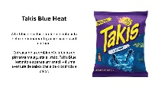
Takis Blue Heat
Nat Rep | Base size: | 400
1.1
Emotional Response
Contempt
Disgust
Anger
Fear
Sadness
Neutral
Happiness
Surprise
Share Trading
Speed of Trading
Percentile
Median Trade Time
Intensity Score
Overall emotional intensity of all (non-neutral) emotions felt, scale from 0-3
76 | ^{th}
07.20 | s
1.1
NPD
Back To Idea Ranking
Takis Blue Heat
20 May 2025

Slide 28
Reasons for Emotion
Nat Rep | Base size: | 400
I don't think it makes sense
It disgusts me a little
It doesn't catch my attention because it's salty
I don't think it makes sense, corn tortilla in blue color doesn't make sense
I don't like pepper in snacks
Contempt
Disgust
Anger
Fear
Sadness
Neutral
Happiness
Surprise
I didn't like the taste
Because of the color
No, I didn't like the color, it doesn't make me want to eat it.
I don't like anything that has pepper in it.
I found it very strange, it didn't match the brand and it made me feel a bit insecure about buying it.
Strange product
I don't think this combination would be good.
Because it's an idea that I neither like nor dislike
I'm not familiar with it.
Nothing to say
I don't like pepper
I'm not familiar with the product.
Intensity Score
Overall emotional intensity of all (non-neutral) emotions felt, scale from 0-3
Beautiful packaging and the taste is eye-catching
Because it looks delicious and would make me happy to eat it.
Delicious
Good idea
Because it seems to be good and makes you happy to eat it.
Because it's a snack unlike anything I've ever seen or eaten
Because it is an innovative idea that could be very successful and sell a lot, I like it.
New product on the market
Because it is spicy
COUNTRY AVERAGE | YOUR IDEA
1.1
NPD
Back To Idea Ranking
Takis Blue Heat
20 May 2025

Slide 29
Advantages & Improvements
Nat Rep | Base size: | 400
Main Advantages of the idea
How to improve the idea
1.1
NPD
Back To Idea Ranking
Takis Blue Heat
20 May 2025

Slide 30
Implicit Attributes
Nat Rep | Base size: | 400
1.1
NPD
Back To Idea Ranking
For values <0.5%, labels report as 0%
Takis Blue Heat
20 May 2025

Slide 31
Target Appeal
Nat Rep | Base size: | 400
1.1
NPD
Back To Idea Ranking
Takis Blue Heat
20 May 2025

Slide 32
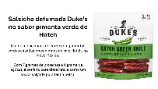
Duke's Smoked Sausages
Nat Rep | Base size: | 400
1.1
Emotional Response
Contempt
Disgust
Anger
Fear
Sadness
Neutral
Happiness
Surprise
Share Trading
Speed of Trading
Percentile
Median Trade Time
Intensity Score
Overall emotional intensity of all (non-neutral) emotions felt, scale from 0-3
75 | ^{th}
07.16 | s
1.1
NPD
Back To Idea Ranking
Duke's Smoked Sausages
20 May 2025

Slide 33
Reasons for Emotion
Nat Rep | Base size: | 400
I prefer a more natural snack option. A healthy snack.
Parsley is already a highly processed product, imagine smoked
It shouldn't be very good, and because it contains pepper, the taste should be very strong, don't worry.
I don't like pepper, it must be horrible
Contempt
Disgust
Anger
Fear
Sadness
Neutral
Happiness
Surprise
is not relevant at all without attraction
Strange
For not knowing the product
It wouldn't be for me but maybe for others I would sell it
Smoked sausage wouldn't sell much because it's often used to make sauces.
It's something that many might not buy.
It's something very different from what I usually consume, so I didn't really buy the idea.
BECAUSE I THINK SMOKED SAUSAGE WOULD NOT BE A GOOD IDEA TO SELL
People who like it will definitely love it.
I think that because it is a salty product it is versatile as it can be used as an appetizer.
It looks tasty and easy to eat.
I love everything that is smoked
For the deliciousness that it must have in flavor
Intensity Score
Overall emotional intensity of all (non-neutral) emotions felt, scale from 0-3
Because I had never seen
It's something that surprised me
Very interesting
Smoked sausage is something different, there can be a lot of chemicals
I could be wrong, but I don't think it's a flavor that isn't very commercial.
COUNTRY AVERAGE | YOUR IDEA
1.1
NPD
Back To Idea Ranking
Duke's Smoked Sausages
20 May 2025

Slide 34
Advantages & Improvements
Nat Rep | Base size: | 400
Main Advantages of the idea
How to improve the idea
1.1
NPD
Back To Idea Ranking
Duke's Smoked Sausages
20 May 2025

Slide 35
Implicit Attributes
Nat Rep | Base size: | 400
1.1
NPD
Back To Idea Ranking
For values <0.5%, labels report as 0%
Duke's Smoked Sausages
20 May 2025

Slide 36
Target Appeal
Nat Rep | Base size: | 400
1.1
NPD
Back To Idea Ranking
Duke's Smoked Sausages
20 May 2025

Slide 37
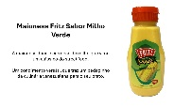
Fritz Salsa Sabor a Maiz
Nat Rep | Base size: | 400
1.0
Emotional Response
Contempt
Disgust
Anger
Fear
Sadness
Neutral
Happiness
Surprise
Share Trading
Speed of Trading
Percentile
Median Trade Time
Intensity Score
Overall emotional intensity of all (non-neutral) emotions felt, scale from 0-3
64 | ^{th}
06.34 | s
1.0
NPD
Back To Idea Ranking
Fritz Salsa Sabor a Maiz
20 May 2025

Slide 38
Reasons for Emotion
Nat Rep | Base size: | 400
Because sweet corn mayonnaise wouldn't go down well and would have a very different flavor.
I don't think the flavor matches
I don't think it's an appropriate flavor for mayonnaise.
I don't think it's a good combination
I don't think it would taste nice
Contempt
Disgust
Anger
Fear
Sadness
Neutral
Happiness
Surprise
It's a flavor that most people won't like.
I believe that this mixture of flavors has absolutely nothing to do with it.
CORN AND MAYONNAISE DON'T GO TOGETHER
The taste must be horrible, the mixing simply doesn't go together.
Corn mayonnaise? What's the point of that, corn kernels are ok, mayonnaise is not
I don't think it would match
I don't think it would be very accepted in Brazilian homes.
Why does green corn taste bad?
I think the packaging conveys sadness
I think it is a brand of little expression and this is largely due to the quality of the product.
I didn't like this idea of mixing mayonnaise with corn
It doesn't catch my attention or please me
I'm not a big fan of corn
Because I don't think corn and mayonnaise go together
I don't think the product would sell in large quantities.
Intensity Score
Overall emotional intensity of all (non-neutral) emotions felt, scale from 0-3
Corn product is wonderful
It looks very tasty to me
Because it's very good
For the qualities
Because it is a well-known and really good brand.
I've seen a lot of things made with corn, but never mayonnaise.
Different flavor.
I found the flavor that was proposed different
Different
I don't see it in the market, I would like to see this idea because I like snacks
COUNTRY AVERAGE | YOUR IDEA
1.0
NPD
Back To Idea Ranking
Fritz Salsa Sabor a Maiz
20 May 2025

Slide 39
Advantages & Improvements
Nat Rep | Base size: | 400
Main Advantages of the idea
How to improve the idea
1.0
NPD
Back To Idea Ranking
Fritz Salsa Sabor a Maiz
20 May 2025

Slide 40
Implicit Attributes
Nat Rep | Base size: | 400
1.0
NPD
Back To Idea Ranking
For values <0.5%, labels report as 0%
Fritz Salsa Sabor a Maiz
20 May 2025

Slide 41
Target Appeal
Nat Rep | Base size: | 400
1.0
NPD
Back To Idea Ranking
Fritz Salsa Sabor a Maiz
20 May 2025

Slide 42
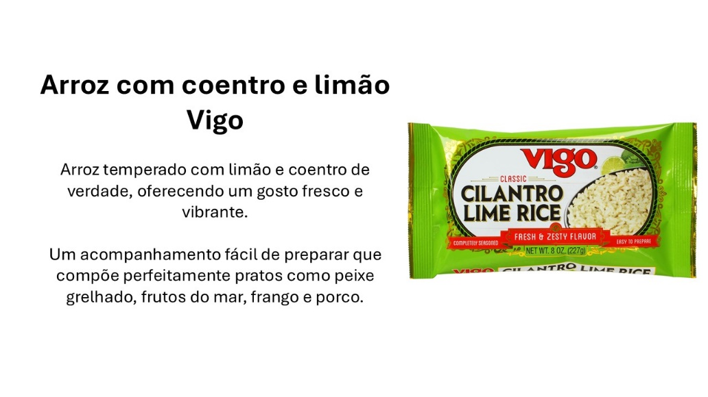
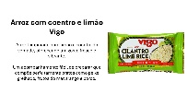
Vigo Cilantro Lime Rice
Nat Rep | Base size: | 400
1.0
Emotional Response
Contempt
Disgust
Anger
Fear
Sadness
Neutral
Happiness
Surprise
Share Trading
Speed of Trading
Percentile
Median Trade Time
Intensity Score
Overall emotional intensity of all (non-neutral) emotions felt, scale from 0-3
72 | ^{nd}
06.96 | s
1.0
NPD
Back To Idea Ranking
Vigo Cilantro Lime Rice
20 May 2025

Slide 43
Reasons for Emotion
Nat Rep | Base size: | 400
I don't like coriander, many people don't like it, it doesn't go well with rice, it doesn't go well with it
Taste must not be good
I don't like coriander
It doesn't go well together.
Because I don't like coriander
Contempt
Disgust
Anger
Fear
Sadness
Neutral
Happiness
Surprise
It seems to taste very bad and I don't think it would be successful in the market.
I don't like the ingredients listed
I don't like coriander
The ingredients do not match each other
The flavor can be very strong
It can be risky because it is new and people may not like it.
because I don't like the flavor and it's not commonly sold.
I don't think the seasonings go well with rice.
Why many people don't eat cilantro and the taste would be strange
Flavor doubt due to lemon
I like coriander, but not everyone likes it.
I NEITHER LIKE NOR DISLIKE THE IDEA BUT I WOULDN'T SELL AND NOBODY WOULD BUY IT
Doubt about the flavor due to the lemon, as it is not used in rice here at home
Intensity Score
Overall emotional intensity of all (non-neutral) emotions felt, scale from 0-3
I liked the product.
Why the product is very good
Many profits
for being new
I don't believe it's attractive
It's something totally different from the market
I've never seen this flavor
Because I had never seen a product with this combination.
It must be good
I believe it is not a product that many people see a lot on the market.
COUNTRY AVERAGE | YOUR IDEA
1.0
NPD
Back To Idea Ranking
Vigo Cilantro Lime Rice
20 May 2025

Slide 44
Advantages & Improvements
Nat Rep | Base size: | 400
Main Advantages of the idea
How to improve the idea
1.0
NPD
Back To Idea Ranking
Vigo Cilantro Lime Rice
20 May 2025

Slide 45
Implicit Attributes
Nat Rep | Base size: | 400
1.0
NPD
Back To Idea Ranking
For values <0.5%, labels report as 0%
Vigo Cilantro Lime Rice
20 May 2025

Slide 46
Target Appeal
Nat Rep | Base size: | 400
1.0
NPD
Back To Idea Ranking
Vigo Cilantro Lime Rice
20 May 2025

Slide 47
Improve
Improve Your Ideas
with Guidance
Optimise your ideas for a successful launch
with recommendations from our experts.
Turn a good idea into the next star for your brand.
Book an Appointment

